Slide 1
Coursera Final Project: IBM Data Science
Farrukh Naveed Anjum
Rawalpindi, Pakistan
ANJUM.FARRUKH@GMAIL.COM

Slide 2
Overview
Introduction
Business Problem
Data
Neighborhoods
Geocoding
Venue Data

Slide 3
Business Problem
Rawalpindi is adjutant city of Islamabad (The Capital of Pakistan). Thousand of people and come here for , Upon arrival in new city Rawalpindi, they need to find hotels to stay in and restaurants for eating food. Also drink brewages in coffee shops.
Goal of the exercise will be to find the ideal spot in the city where hotel can be built for maximizing the profits

Slide 4
Data
Neighborhoods
Data for the neighborhoods in Rawalpindi can be scrapped from Wikipedia using BeautifulSoup library. We will use this data.
Geocoding
We will use rawalpindi.csv data. Import into the Pandas Data Frame. Lat, Long (Geo Spatial Data) can be retrieve using FourSquare API.
It will be persisted into data frame and we will store it for later on use.
Venue Data
We will find the venues using Foursquare API. Create another data frame, that will contain the venue details along with there respective neighborhoods.

Slide 5
Methodology
Accuracy of GeoEncoding
During first phase of development with Geocoder API, the number of erroneous results were of an great amount, which led to the development of an algorithm to analyze the accuracy of the Geocoding API used.
In the algorithm developed, Geocoding API from various providers were tested, and in the end, Google Maps Geocoder API turned. out to have the least number of collisions (errors) in our analysis.
Folium
It has the data wrangling strengths of the Python ecosystem and the mapping strengths of the leaflet.js library. All cluster visualization are done with help of Folium which in turn generates a Leaflet map made using OpenStreetMap technology.

Slide 6
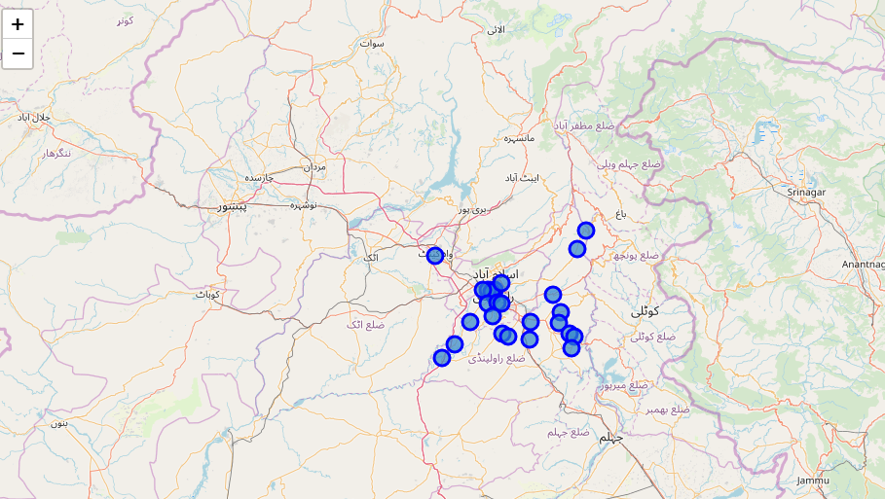
Methodology
Figure: Neighborhoods of Rawalpindi.

Slide 7
Methodology
One Hot Encoding
One hot encoding is a process by which categorical variables are converted into a form that could be provided to ML algorithms to do a better job in prediction.
For the K-means Clustering algorithm. All unique items under Venue Category are one-hot encoded.
Top 10 most common venues
As we have vast variety in the venues, only the top 10 common venues are selected and a new Data Frame is made, which is used to train the K-means Clustering Algorithm.

Slide 8
Methodology
Optimal Numbers of Clusters
Silhouette Score is a measure of how similar an object is to its own cluster (cohesion) compared to other clusters (separation). The silhouette ranges from -1 to +1, where a high value indicates that the object is well matched to its own cluster and poorly matched to neighboring clusters.
As per the Silhouette Score of various clusters below 20, the optimal cluster size.

Slide 9
Methodology
KMeans Clustering
The venue data is then trained using KMeans Clustering Algorithm to get the desired clusters to base the analysis on. KMeans was chosen as the variables (Venue Categories) are huge, and in such situations KMeans will be computationally faster than other clustering algorithms.

Slide 10
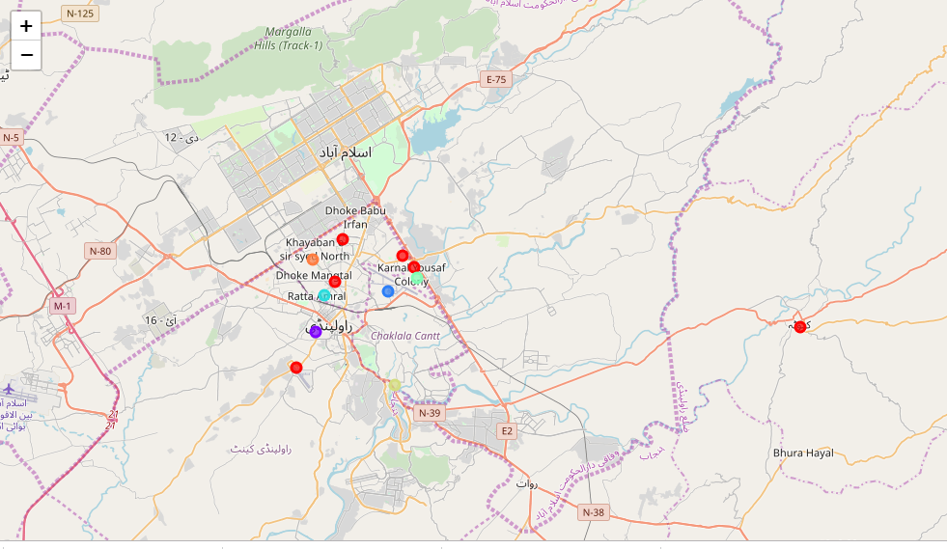
Results
The neighborhoods are divided into N clusters where N is the number of clusters found using the optimal approach. The clustered neighborhoods are visualized using different colors so as to make them distinguishable.
Figure: Neighborhoods of Rawalpindi (Clustered)

Slide 11
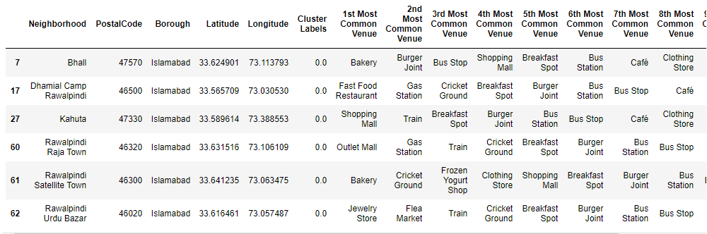
Discussion
Five places namely Bhall, Dhamial Camp, Kahula, Raja Town, Satellite Town and Urdu Bazar falls near market or either bus stations. Hence are in same cluster.
Figure: Cluster having Train as most common venue

Slide 12
Conclusion
The middle class in Pakistan can loosely be defined as the section of society that comprises households with a minimum monthly income of $320. A household on average consists of six members. If this categorization is correct in a broad sense, the size of the middle class in our country has grown to nearly 50 million of Pakistan’s total population of 200 million. This estimate is not based on any scientific survey but on anecdotal evidence and social observations. However, one can argue that the size of Pakistan’s upper middle class is smaller, not exceeding 20 million at best.
Hence opening the a Hotel (Along with Restaurant) near railway stations area can get one $1250 per day profit in case average of 50 people stay there.

